Slide 1
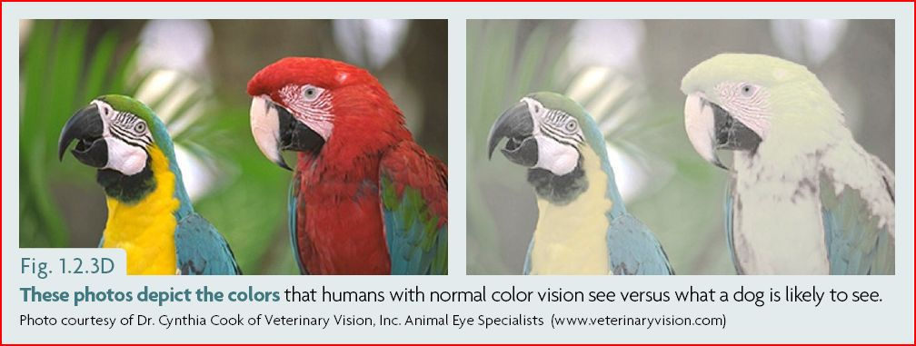

Slide 3
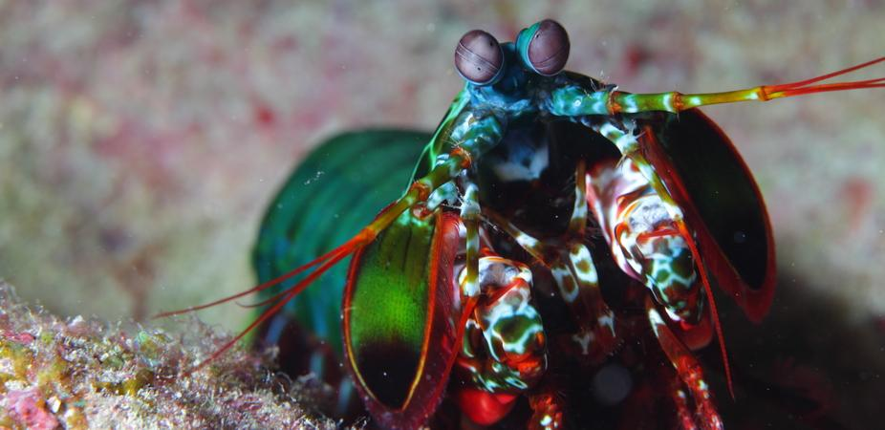

Slide 4
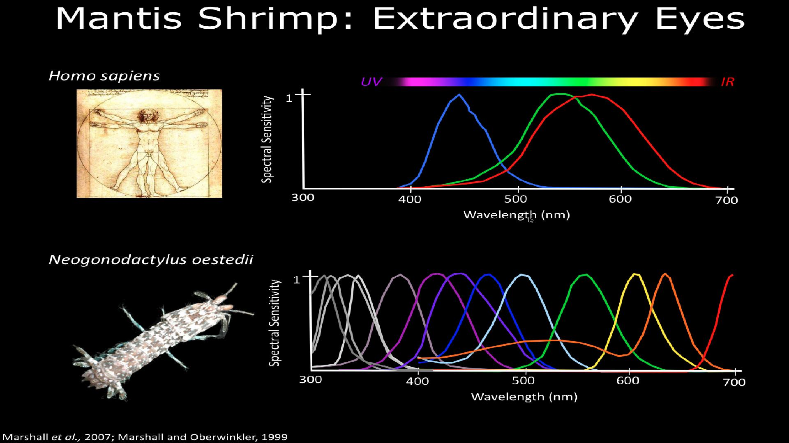

Slide 5
EXPERT MINER
Team biteCode
Gihan Chanaka Jayatilaka
Harshana Sumedha Weligampola
Suren Sritharan

Slide 6
DISCOVERING EARTH RESOURCES IN SRI LANKA USING
HYPERSPECTRAL IMAGERY (HSI)
Objective : To pinpoint the earth resource locations in the country

Slide 7
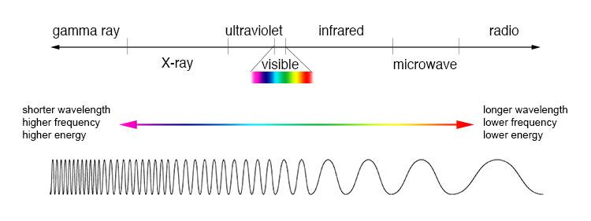
The Electromagnetic Spectrum

Slide 8
Normal RGB Cameras
3 colour bands

Slide 9
Hyperspectral Cameras
103 colour bands

Slide 10
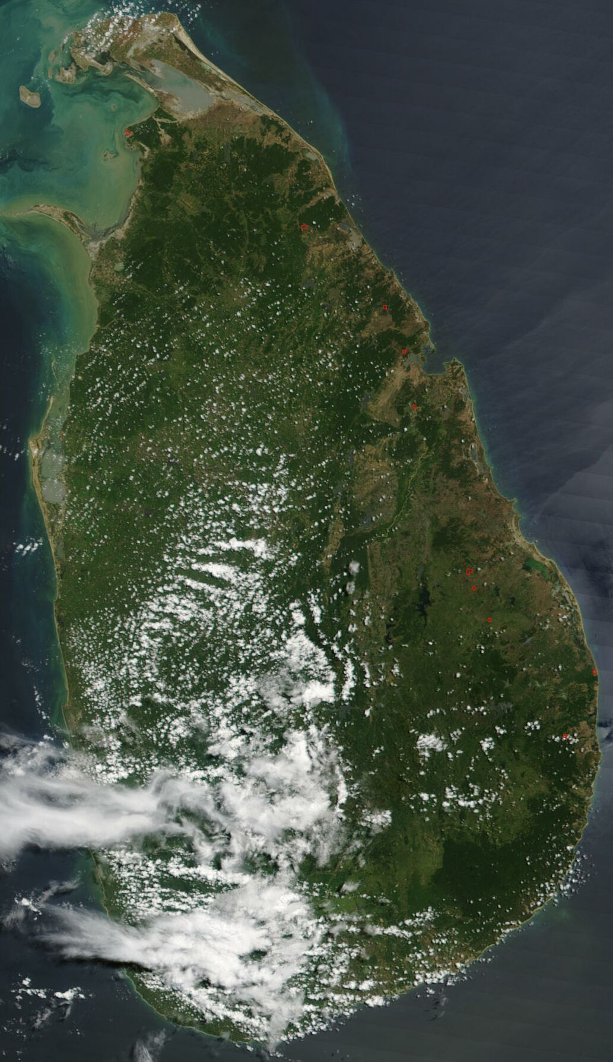

Slide 11
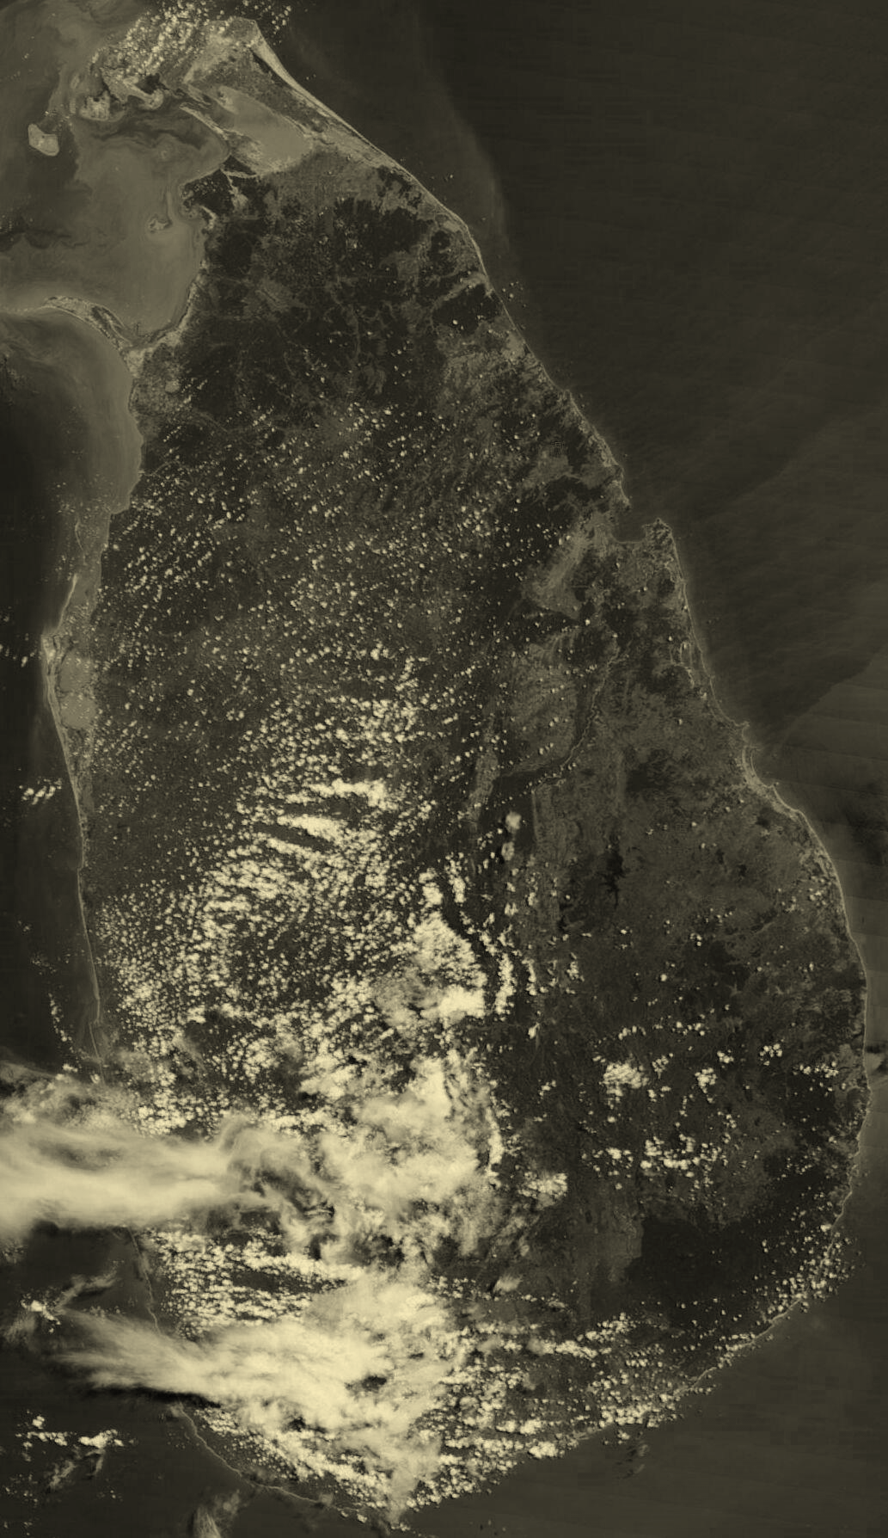

Slide 12


Slide 13
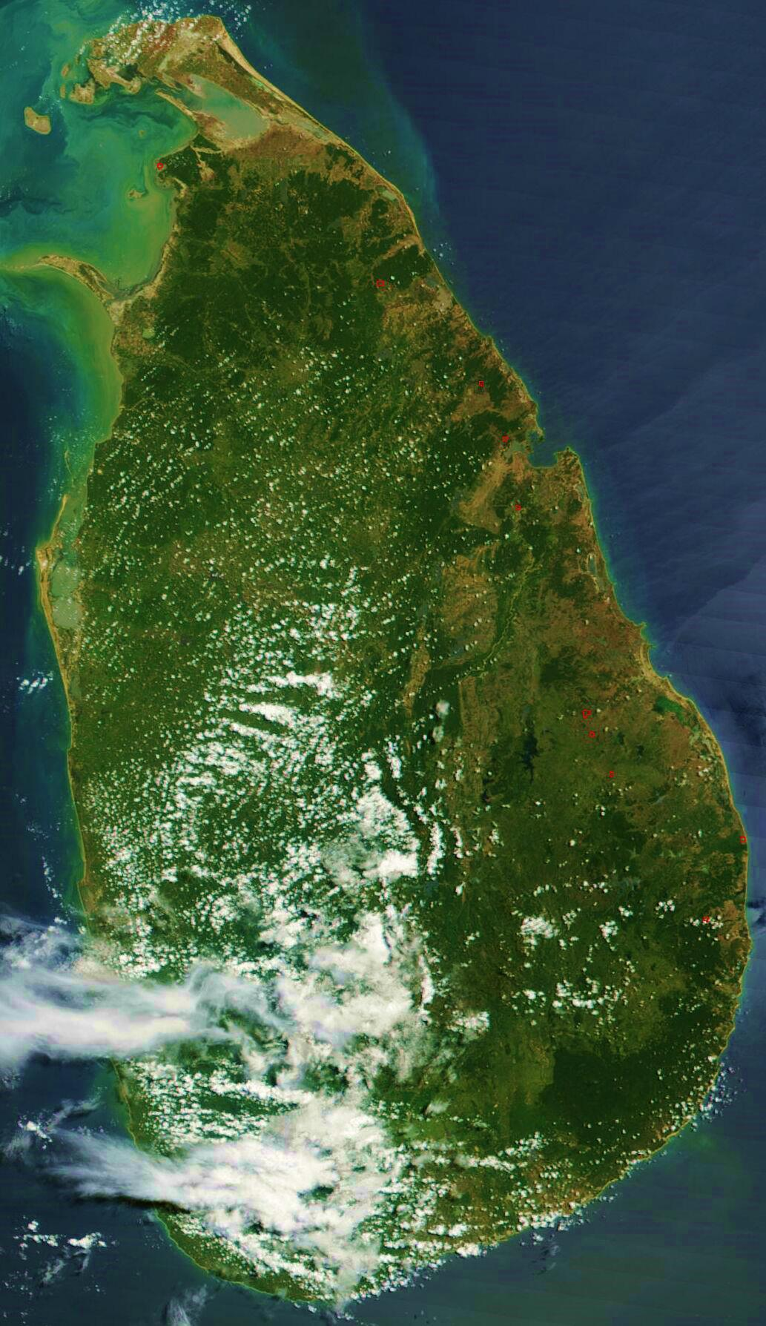

Slide 14
Why HSI?
RGB photographs do not show any difference for a land with or without a certain mineral underneath.
But these minerals tend to reflect/emit the EM waves differently in other bands of the spectrum.

Slide 15
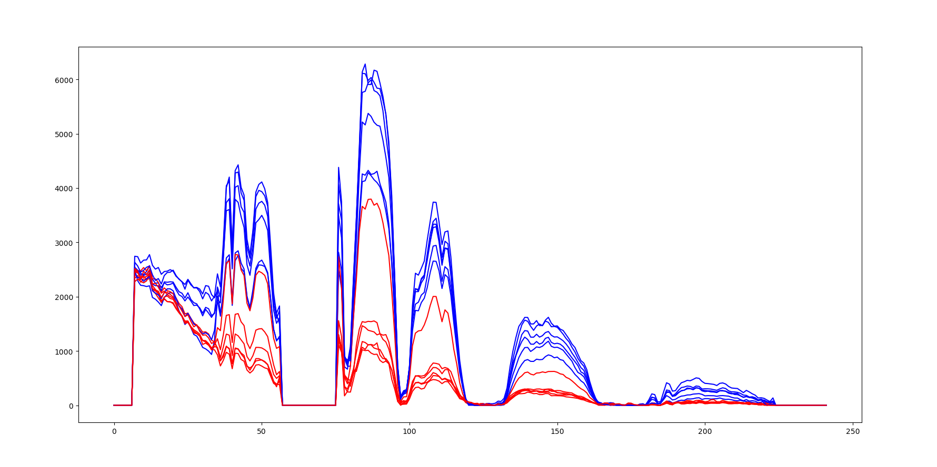

Slide 16
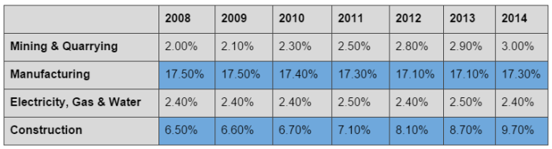

Slide 17
Impact
Sri Lanka earns 1.2 Billion USD per annum from mining earth resources.
But this is less than 2% of the GDP.
Reliable and cheap prediction WHERE to mine can increase the mining by a several fold.

Slide 18
Thank you!

